Slide 1

Mobile App Development II COMP3097
Lecture 4
Przemyslaw Pawluk

Slide 2
Table of contents
Stroryboarding
Navigation
Communication between controllers

Slide 3
Storyboard

Slide 4
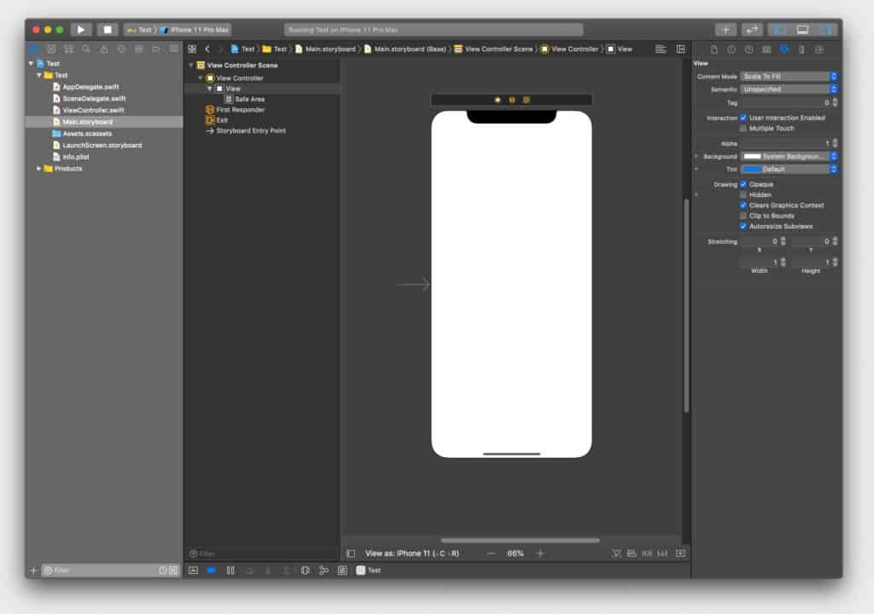

Slide 5
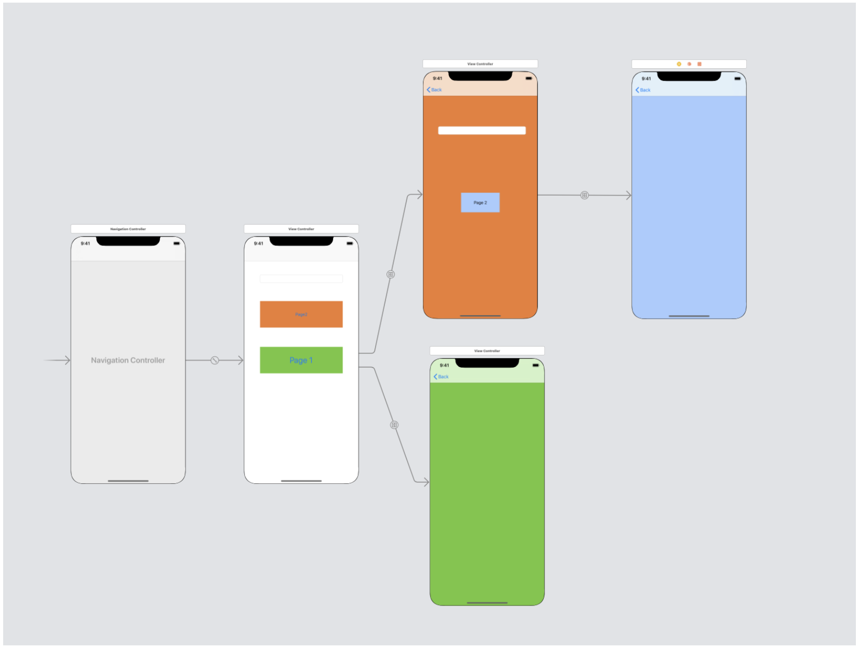
Navigation in storyboard

Slide 6
Segues
A segue defines a transition between two view controllers in your app’s storyboard file.
The starting point of a segue is the button, table row, or gesture recognizer that initiates the segue.
The end point of a segue is the view controller you want to display.
A segue is “one way” and always presents a new view controller, but you can also use an unwind segue to dismiss a view controller.

Slide 7
Segues
A segue defines a transition between two view controllers in your app’s storyboard file.
The starting point of a segue is the button, table row, or gesture recognizer that initiates the segue.
The end point of a segue is the view controller you want to display.
A segue is “one way” and always presents a new view controller, but you can also use an unwind segue to dismiss a view controller.
IMPORTANT NOTE!
DO NOT create cyclic segues!
Use the unwind segue to go back

Slide 8
Segues
At runtime, UIKit loads the segues associated with a view controller and connects them to the corresponding elements.
When the user interacts with the element, UIKit loads the appropriate view controller, notifies your app that the segue is about to occur, and executes the transition.
You can use the notifications sent by UIKit to pass data to the new view controller or prevent the segue from happening altogether.

Slide 9
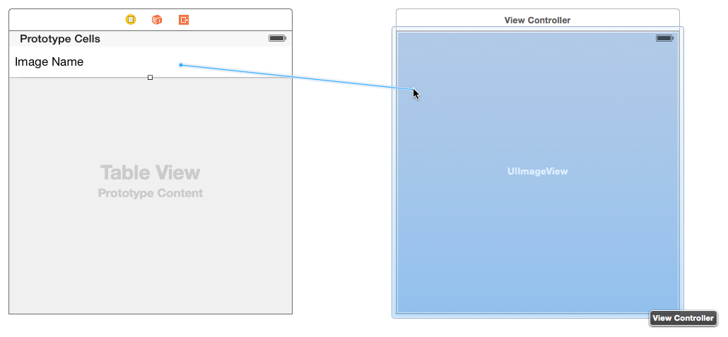
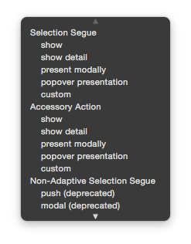
Create segue

Slide 10
Segue types
Show - Pushes the destination view controller onto the navigation stack, sliding overtop from right to left, providing a back button to return - if not embedded in a navigation controller it will be presented modally Example: Navigating in Settings, for example tapping General > About
Show Detail - For use in a split view controller, replaces the secondary view controller when in a multi-column interface, or if collapsed to one column it will push in the navigation controller Example: In Messages, tapping a conversation will show the conversation details - replacing the view controller on the right when in a two column layout, or push the conversation when in a single column layout
Present Modally - Presents a view controller overtop the current view controller in various fashions as defined by the modal presentation and transition style - most commonly used to present a view controller in a sheet that animates up from the bottom Example: Selecting Face ID & Passcode in Settings

Slide 11
Segue types
Popover Presentation - When run on iPad, the destination appears in a popover, and tapping anywhere outside will dismiss it - popovers are supported on iPhone as well but by default it will present the view controller modally Example: Tapping the + button in Calendar
Custom - You may implement your own custom segue and have control over its behavior
Embed - You may embed a view controller into another view controller, such as navigation, tab bar, and split view controllers as well as custom containers
Unwind - You may use an unwind segue to navigate back to a previous view controller, even if there’s many screens pushed/presented on top all of them will be dismissed

Slide 12
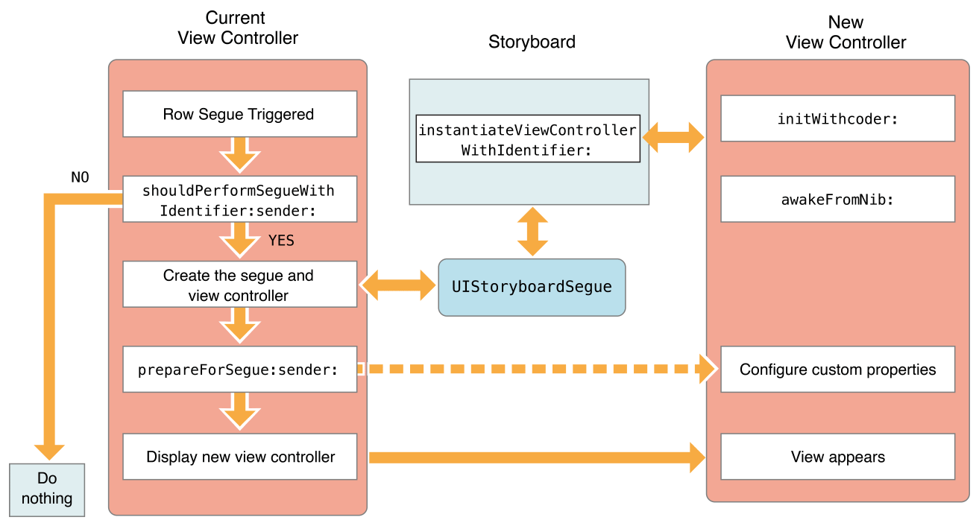
Displaying view controller using segue

Slide 13
Segue execution
During a segue, UIKit calls methods of the current view controller to give you opportunities to affect the outcome of the segue.
The shouldPerformSegueWithIdentifier:sender: method gives you an opportunity to prevent a segue from happening. Returning NO from this method causes the segue to fail quietly but does not prevent other actions from happening. For example, a tap in a table row still causes the table to call any relevant delegate methods.
The prepareForSegue:sender: method of the source view controller lets you pass data from the source view controller to the destination view controller. The UIStoryboardSegue object passed to the method contains a reference to the destination view controller along with other segue-related information.

Slide 14
Unwind
Unwind segues let you dismiss view controllers that have been presented. You create unwind segues in Interface Builder by linking a button or other suitable object to the Exit object of the current view controller.
When the user taps the button or interacts with the appropriate object, UIKit searches the view controller hierarchy for an object capable of handling the unwind segue. It then dismisses the current view controller and any intermediate view controllers to reveal the target of the unwind segue.

Slide 15
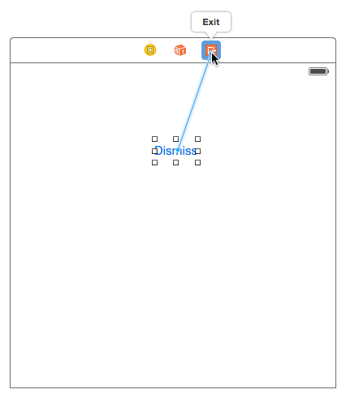
Unwind
Choose the view controller that should appear onscreen at the end of an unwind segue.
Define an unwind action method on the view controller you chose.
The Swift syntax for this method is as follows:
@IBAction func myUnwindAction (unwindSegue: UIStoryboardSegue)

Slide 16
Unwind
Navigate to the view controller that initiates the unwind action.
Control-click the button (or other object) that should initiate the unwind segue. This element should be in the view controller you want to dismiss.
Drag to the Exit object at the top of the view controller scene.
Select your unwind action method from the relationship panel.

Slide 17
Initiating a Segue Programmatically
Segues are usually triggered because of the connections you create in your storyboard file. However, there may be times when you cannot create segues in your storyboard, perhaps because the destination view controller is not yet known.
For example, a game app might transition to different screens depending on the outcome of the game. In those situations, you can trigger segues programmatically from your code using the performSegueWithIdentifier:sender: method of the current view controller.

Slide 18
Initiating a Segue Programmatically
func tableView(tableView: UITableView, didSelectRowAtIndexPath
indexPath: NSIndexPath) {
performSegueWithIdentifier("SomeSpecificIdentifier",
sender: indexPath.item)
}

Slide 19
Passing data between

Slide 20
Passing data
Segue gives access to both source and destination controller
Segues should have identifiers allowing you to determine the destination type
You can use properties of the destination controller and/or delegates to pass the data

